Slide 1
CSCI 332 TERM PROJECT-Task 1
Timia davis & christopher chism

Slide 2
Setup/Receiving/receiving
Enter user listening port
Enter buddies listening port
Enter buddies ip address
Send messages back and forth and enjoy!!

Slide 3

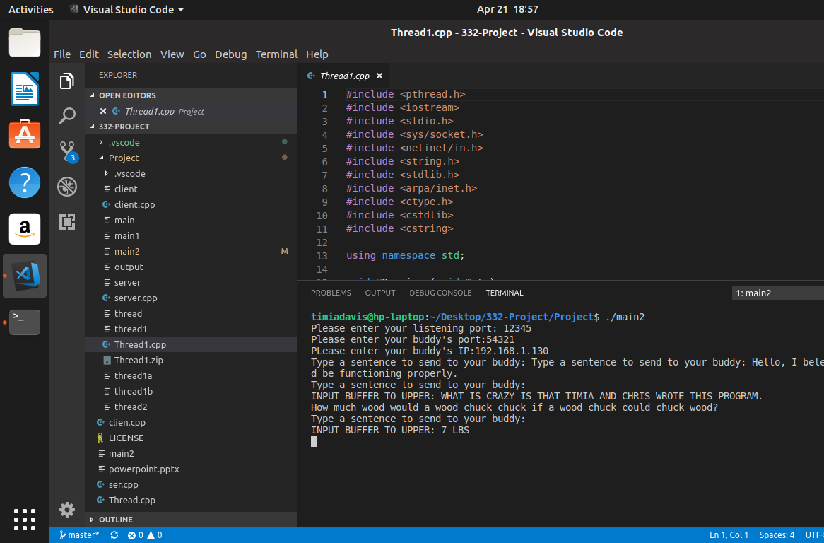
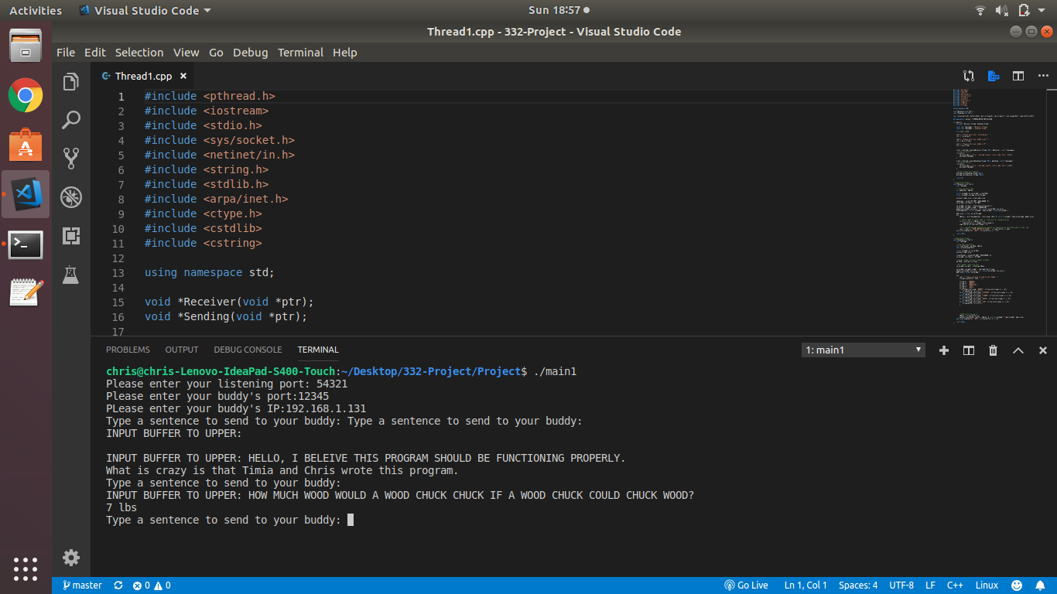

Setup/Receiving/receiving

Slide 4
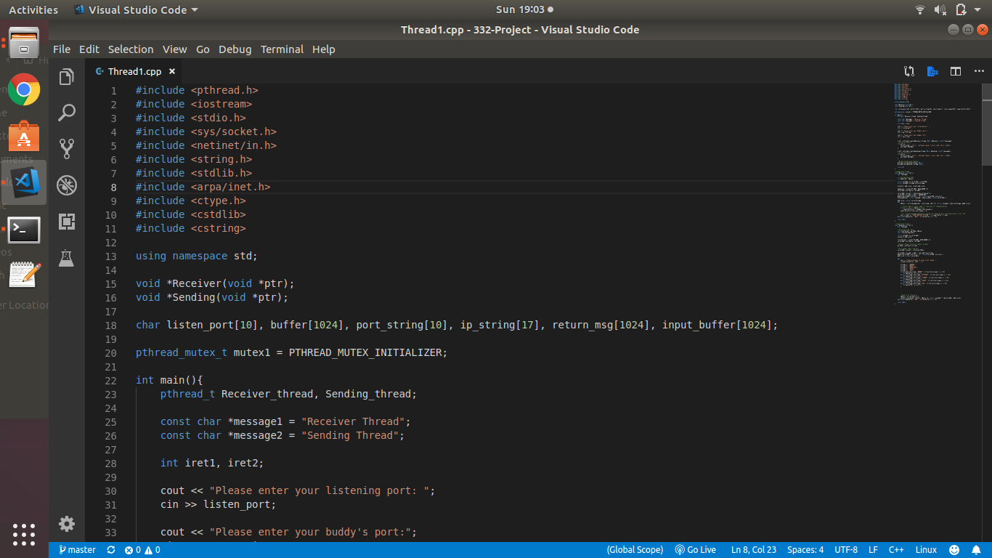
Source code

Slide 5
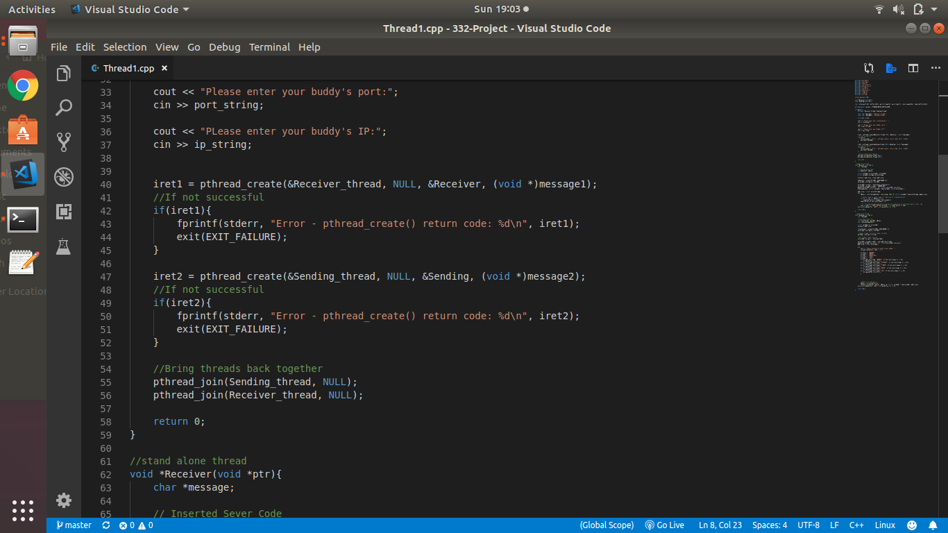
Source code

Slide 6
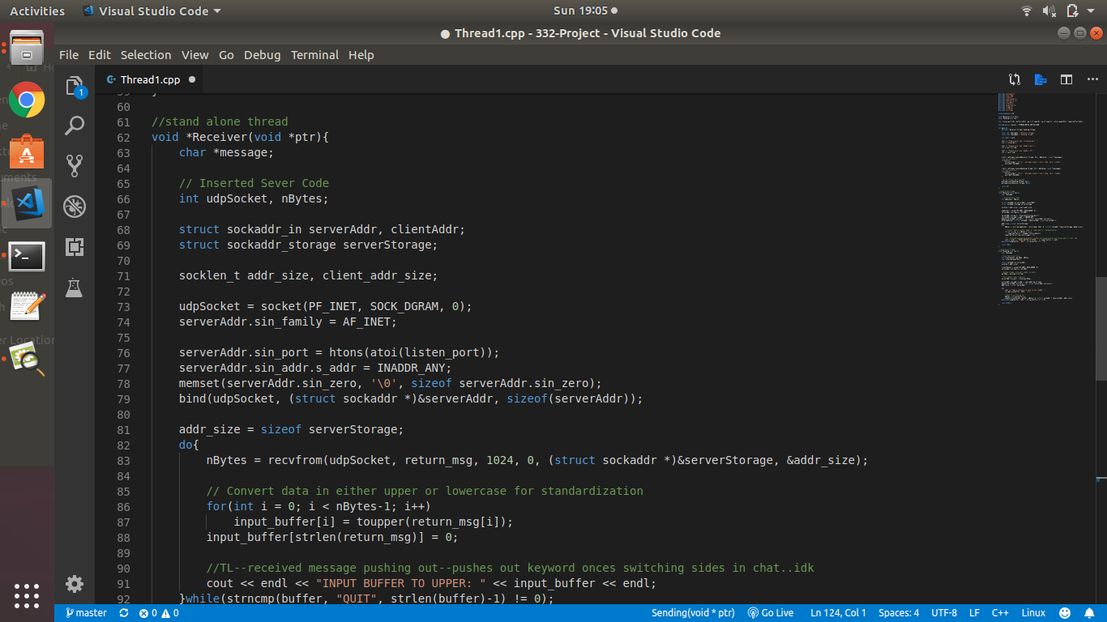
Source code

Slide 7
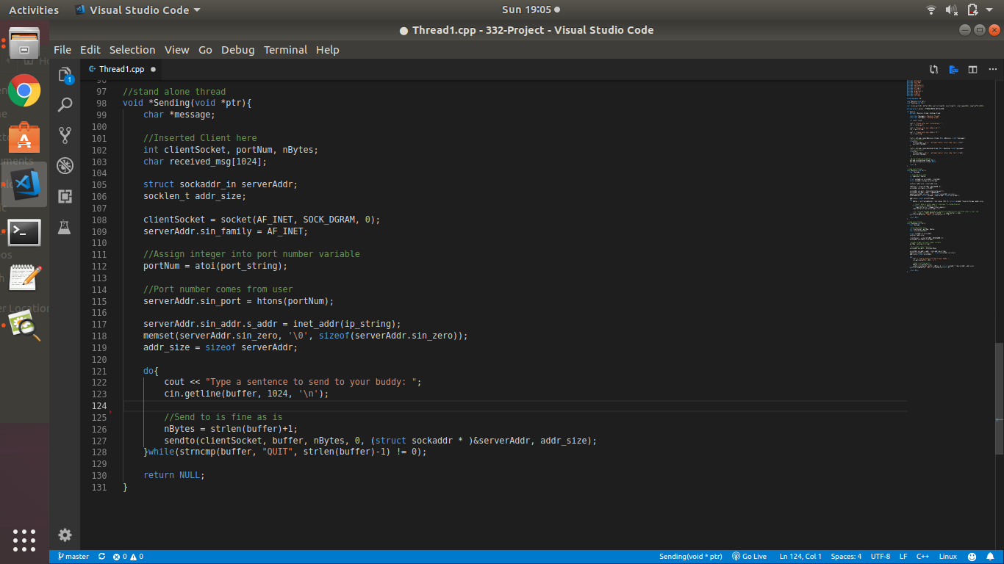
Source code

